Slide 1
Presented by
Edward Tanzer

Slide 2
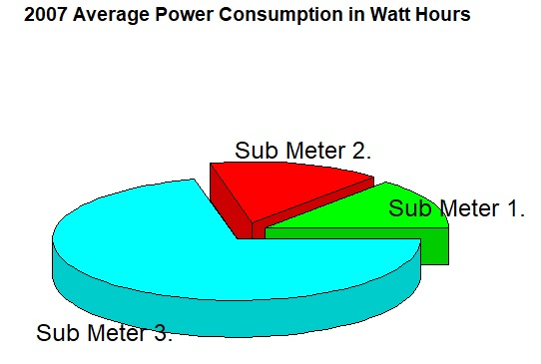
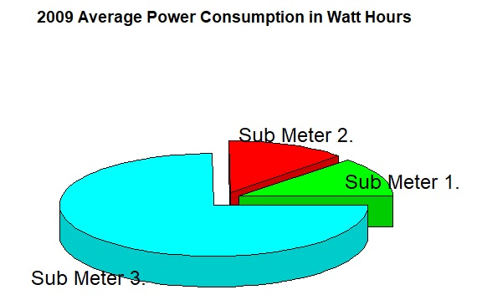
Sub Meter Analysis
Notes:
-Investigate changes in electrical use between sub meters | Sub 1 = kitchen, dishwasher, oven, microwave.
-2007– 1.2, 1.6, 5.7 | Sub 2 = Laundry room, washing machine, refridgerator, light.
-Sub meter 1 makes up 14 percent | Sub 3 = Water-heater and air-conditioner.
-Sub meter 3 makes up 67 percent
-2009 - 1.1, 1.1, 6.7
-Sub meter 1 makes up less than 13 percent
-Sub meter 3 makes up nearly 75 percent
-Power consumption formula from UCI Machine Learning Repository

Slide 3
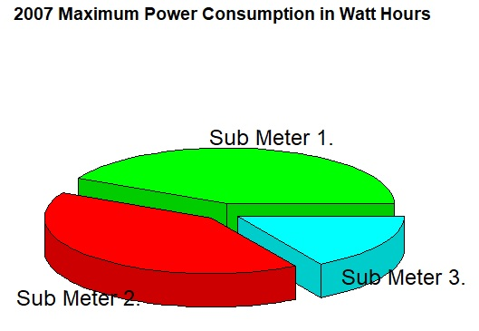
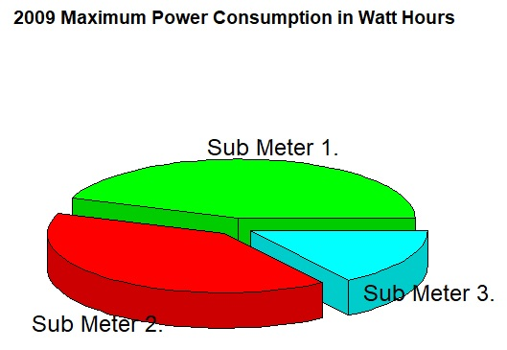
Sub Meter Analysis
Notes:
-2007– 79, 76, 31
-Sub meter 1 makes up 42 percent
-Sub meter 3 makes up 17 percent
-2009 – 88, 79, 31
-Sub meter 1 makes up 44 percent
-Sub meter 3 makes up 16 percent

Slide 4
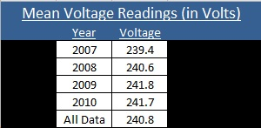
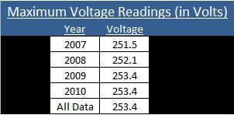
Home Voltage Readings
Notes:
-Highest the average voltage should go would be 220 volts with a 5% variance - 232
-Possible high charges on electric bills
-Shorten life span of consumer electrical devices
-7.5-9.5 kWatts (Air conditioner and water heater)

Slide 5
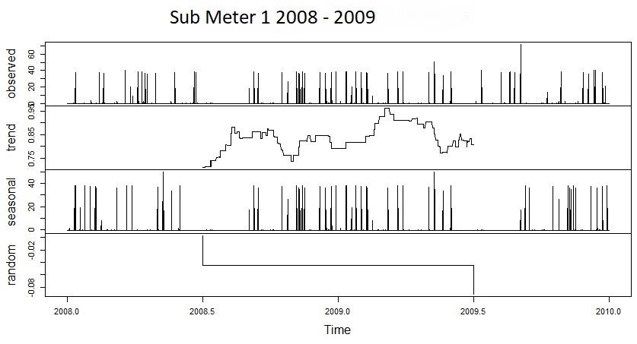
Sub Meter 1 Analysis

Slide 6
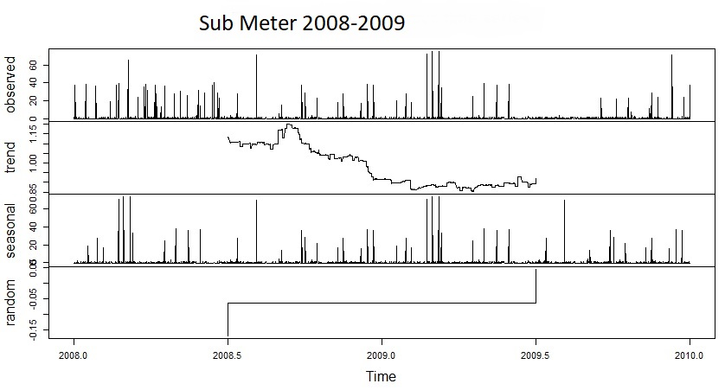
Sub Meter 2 Analysis

Slide 7
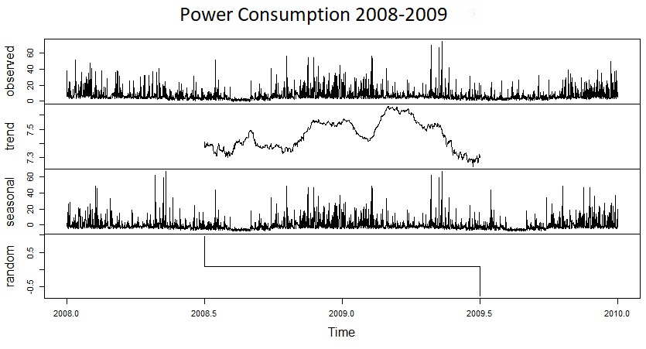
Power Consumption

Slide 8
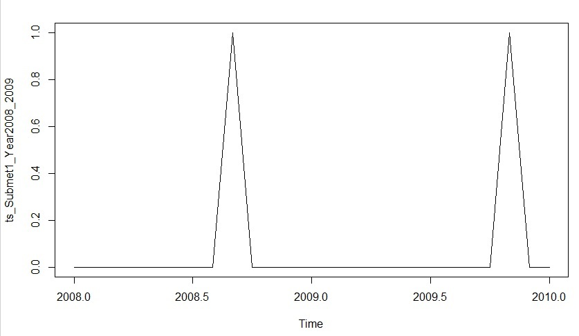
Sub Meter 1

Slide 9
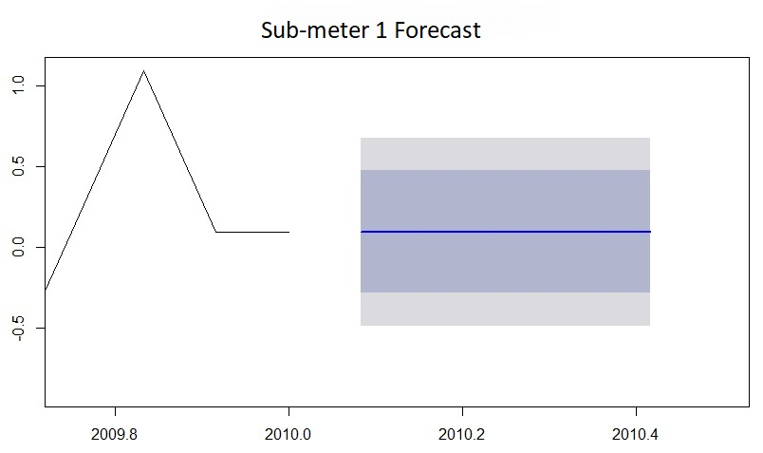

Slide 10
Outro: Questions?

